Slide 1
Data Pipelines - II
Pravin Y Pawar

Slide 2
Agenda
Data Analytics Pipelines
Need and Origin
Use cases
Types
Testing

Slide 3
Data Analytics Pipelines

Slide 4
Immature Data and Analytics Processes
Drawing Swords!
Though data is a critical business asset
most organizations still don’t have mature processes for converting data into insights that drive business value
The development of data and analytics pipelines,
is still a handcrafted and largely non-repeatable process with minimal reuse,
managed by individuals working in isolation with different tools and approaches
The result is
a plodding development environment that can’t keep pace with the demands of a data-driven business
an error-prone operational environment that is slow to respond to change requests
Drawing Swords
The lack of efficiency on the development side leads to a lack of effectiveness on the business side
Business and IT draw swords and go to war instead of partnering

Slide 5
Data Pipelines
Origin
Emerged from the big data community
Data lakes created a feeding frenzy among developers, data scientists, and data analysts
gained unfettered access for the first time
to a nearly limitless supply of raw data sourced
from a multiplicity of internal and external systems
Created a wide diversity of workflows and programs—or data pipelines—to process that data
(e.g., clean, filter, aggregate, move, load)
for a variety of purposes and use cases

Slide 6
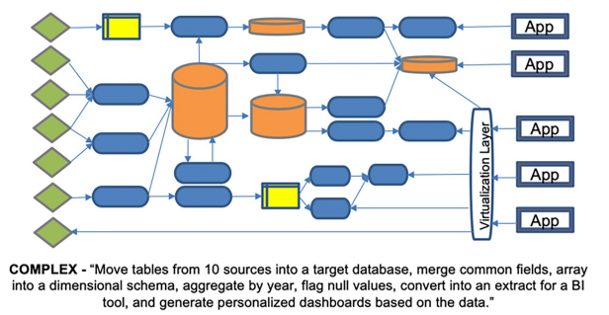
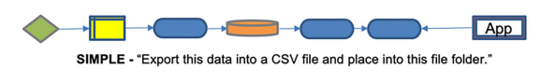
Data Pipelines(2)
Simple vs Complex
Represents the encoded flow of data from source to consumption
Some data pipelines are simple:
“Export this data into a CSV file and place into this folder.”
But others are complex:
“Move tables from 10 sources into a target database, merge common fields, array into a dimensional schema, aggregate by year, flag null values, convert into an extract for a BI tool, and generate personalized dashboards based on the data.”

Slide 7
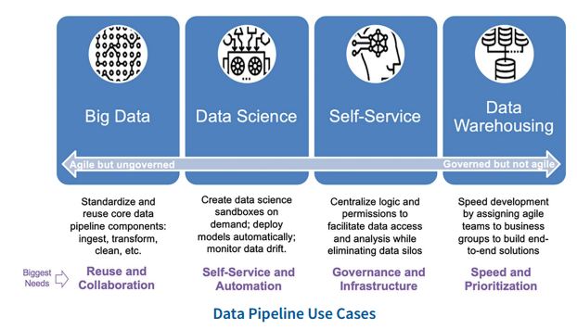
Data Pipelines(3)
Use Cases

Slide 8
Data Pipelines(4)
Two types
A development pipeline
creates code to process data for a new pipeline
An execution pipeline
runs the pipeline in production
In most IT shops
these are managed by different teams, creating tremendous inefficiencies
developers can build or change code without being responsible for its downstream impacts
inevitably increases error rates, delays delivery and frustrates business users

Slide 9
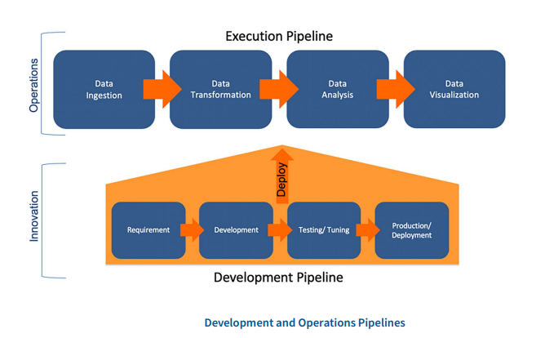
Data Pipelines(4)
Development and Execution Pipelines

Slide 10
Data Pipelines(5)
Generic Pipeline (Major)
Although most data analytics pipelines are fairly complex, with dozens or hundreds of steps, most consist of the following stages:
Data Ingestion
Data from various sources is extracted, validated, and loaded into downstream systems.
Data Transformation
Data is cleansed, enriched, integrated, and modeled to support the target application or data structure.
Data Analysis
Data is analyzed refined, and packaged in data models to provide certain insights or fulfill a task.
Data Visualization
Data is visualized in a suitable manner, e.g., a static report or an interactive dashboard.

Slide 11
Data Pipelines(6)
People and Tools
Data analytics pipelines
often span multiple functions supported by different specialists
who use a variety of tools and technologies
A data engineer
uses ETL or data preparation tools
to extract data from a source and load it to a central data warehouse or data set
A BI developer
uses a visualization tool
to build a chart, report or dashboard which is consumed by business users
A data scientist
might then use Python or R
to build a predictive model that provides data for a business application managed by a software developer

Slide 12
Data Pipelines(7)
Micro Pipeline
To manage this complexity, it helps to divide individual stages into micro-pipelines
to ensure that changes can be made to each step without disrupting the entire flow
The micro-pipelines consist of the following steps:
Requirement
Agile methods, such as Scrum and Kanban, elicit requirements from stakeholders in an iterative manner
A requirement could be the integration of a new data source in an ETL process or the addition of a new field to a database table
Development
In data and analytics, development does not necessarily mean programming
it can comprise tasks like changing a data model or reconfiguring a dash-board
Requires a high level of automation
e.g., automatically generating database queries when a model is changed, to avoid repetitive manual work

Slide 13
Data Pipelines(8)
Micro Pipeline
Testing/Tuning
Testing is often neglected in data and analytics, as building an adequate testing environment in complex analytics solutions can be difficult
Many tools simply lack testing functions
Production/Monitoring
After testing, changes are deployed to production
Should be a fully automated, documented, and easily reversible
Orchestration and Automation
A key function is to orchestrate and automate the flow of data and code between people and tools in an efficient manner
that ensures clean handoffs and minimal errors and disruptions
With complex pipelines, this can be challenging, making orchestration and automation key facilities in any implementation

Slide 14
Testing
Need
Tests are central to both types of pipelines
In development pipelines, the data is fixed but code is variable
In production the data is variable and code is fixed
Development tests the code, and production tests the data!
Teams must build tests for both types of pipelines
run them continuously in both development and production
to ensure that changes don’t adversely affect outcomes
which accelerates development and minimize operational delays
Unfortunately, too many development shops make changes, perform minimal tests,
then cross their fingers that the changes don’t break something!

Slide 15
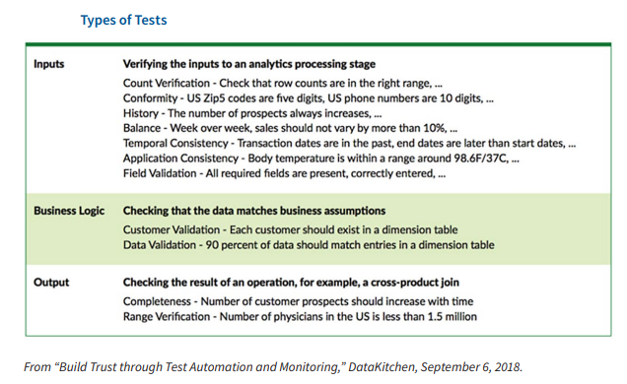
Testing(2)
Types of Tests
Finding issues before internal customers do is critically important for a development team
Three types of tests
Data input tests prevent bad data from entering a new node in a pipeline stage
Business logic tests validate that data matches business assumptions
Data output tests verify that a pipeline stage executed properly

Slide 16
References
The Ultimate Guide to DataOps Product Evaluation and Selection Criteria
DataOps: Industrializing Data and Analytics Strategies for Streamlining the Delivery of Insights
IBM DataOps How and Why Whitepaper

Slide 17
Thank You!

